Slide 1
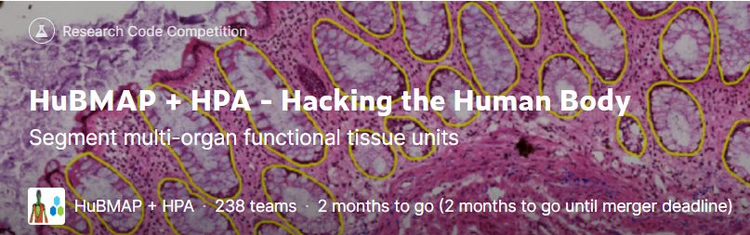
HuBMAP + HPA – Hacking the Human Body
Progress Meeting 9 Group A
https://www.kaggle.com/competitions/hubmap-organ-segmentation

Slide 2
01
Muti-organ training
CONTENTS
02
Stain Normalization
03
Further improvements

Slide 3
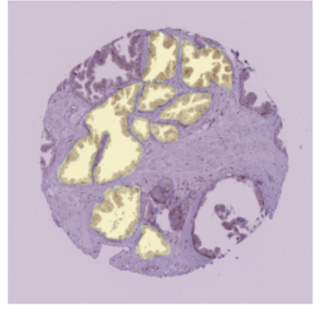
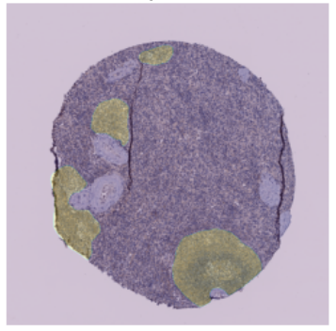
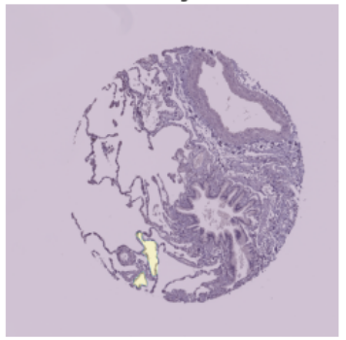
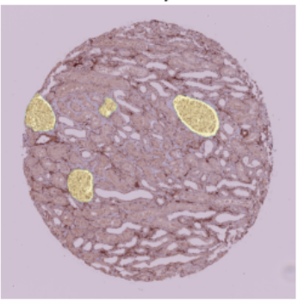
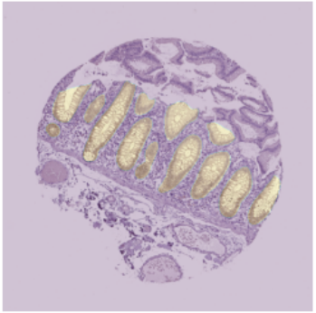
STRATEGY
MULTI-ORGAN TRAINING
There are five kinds of organs in the training dataset:
Prostate
Spleen
Lung
Kidney
Largeintestine
Prostate
Spleen
Lung
Kidney
Largeintestine

Slide 4
STRATEGY
MULTI-ORGAN TRAINING
From pictures below, we can see that there are great difference between different organ tissues. Thus, we are going to utilize information about organ categories.
Method 1: Train five different models for 5 kinds of organ dataset.
Method 2: Train one multi-classes models.
Prostate
Spleen
Lung
Kidney
Largeintestine

Slide 5
STRATEGY
METHOD 1
We trained five different groups of models:

Slide 6

STRATEGY
METHOD 1
In the first inference code, notebook threw exception after submission.
After some experiments, we found that the reason for the error is that the number of organs in test.csv is more than the number of organs in the train.csv.
After fixing this error, the score even lower than the score of baseline (0.56).

Slide 7
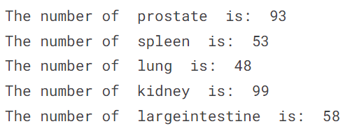
STRATEGY
METHOD 1
We think the reason for the decline in scores may be that there is too little data in the dataset of each organ.
PLAN:
Train the encoder of the model with the whole dataset and train the decoder of the model with particular organ dataset. Because we want the model to learn common information of tissue cells such as texture, shape and color by using the whole dataset.

Slide 8
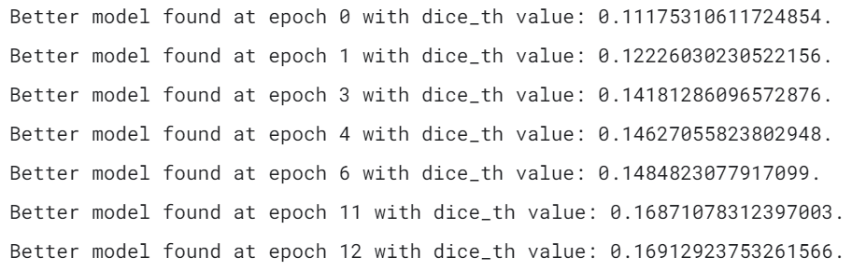
STRATEGY
METHOD 1
In the training processing, it is very difficult to train lung dataset.
We should do some additional steps to lung dataset.
New data augmentation method
Manually label more lung images

Slide 9

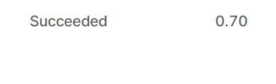
2.1 Data augmentation about colour
Remove the colour augmentation method from the original data augmentation
After the Normalization, the original datas’ colour becomes similar
However, some functions in the original data augmentation strategies change the colour of the processed data
Make a new data set, combine the normalization set and the original one and train them
take that normalization set and put the original dataset together, and it becomes a new data set that has about twice as much data

Slide 10
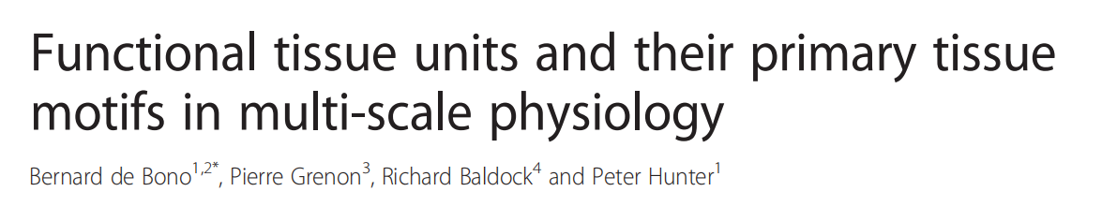
2.2 Data augmentation about geometric
Delete data augmentations methods related to deformation
One of the criteria used by experts to identify FTUs is the diffusion distance between FTUs in each cell, but using deformation-related data augmentation methods may change this distance.

Slide 11
STRATEGY
FUTURE IMPROVEMENT
Try method 2: Train one multi-classes models.
Do something to lung dataset
Train the encoder of the model with the whole dataset and train the decoder of the model with particular organ dataset.
Delete data augmentations methods related to deformation

Slide 12
Thank You!

